Slide 1

SHIVAJIRAO S. JONDHALE COLLEGE OF ENGINEERING DEPARTMENT OF COMPUTER ENGINEERING
MINI PROJECT
PRESENTATION
PROJECT NAME
ABSENCE REQUEST AND VACATION SCHEDULE MANAGEMENT SYSTEM
PRESENTED BY:-
ADITI A. KEMBULKAR(49)
ROHAN S. JAWALE(39)
SARVESH A. KARANDE(47)
GUIDED BY:-
PROF.MRS.PALLAVI CHANDRATE

Slide 2
FLOW OF PRESENTATION
Introduction
Problem Statement
Literature Survey
Proposed System
Block Diagram
Flow Chart (Employee)
Flow Chart (Authority)
Vacation Scheduling
Advantages
Conclusion
References

Slide 3
INTRODUCTION
The existing Absence Management system is manual. It is a lengthy process and it is not optimized.
We are creating Absence Request and Vacation Schedule Management based on python-flask to help solve this problem. We provide a system which manages the employee leave procedures.
The employee fills and submits the leave application form through our website.
The authority gets notified and can decide to grant, reject or keep the application form pending. We will be trying to make a program to help employees get a easy and fast absence requests without much worry.

Slide 4
Problem Statement
One of the major concerns of many organizations is problems about the absences of their employees. Maintaining a manual record of the leave and vacation schedule is a hard task.
Therefore, our project aims at making absence requests an easier task for the employees, as well as the authority. It is also noticed that leave applications take a long time for approval. Hence, our project also targets to make this process time efficient.
We are developing a Python based website, using MySQL for the database connectivity, Html and CSS used as back-end This system can be used to automate the workflow of absence requests and their approvals. There are features like notifications, first come first serve, easy approval of leave, etc in our system.

Slide 5
Literature Survey
SR.NO | YEAR | NAME OF RESEARCH PAPER | NAME OF THE AUTHORS | EXISTING SYSTEM | CONS
1. | 2018 | Employee Leave Management System(ISSN)2229-5518 | FreeStudentsProjects | Record of leaves of all the employess | Security Risk
2. | 2011 | Leave Management System | Sai Ba Oo,Suparat Chainan | Leave application by employee and granting and rejection by authority | To calculate leave balance from a fix amount of annual leave was not available

Slide 6
PROPOSED SYSTEM
Absence management system was designed for an employee to apply for leave online. There will be less time consuming and also less expenses on stationery compared to the process of filling in the forms manually.
Below are certain objectives that should be gain in this project:
To apply leave online (Employee)
To receive leave application from staff online by auto generated email (Authority)
To approve or reject staff leave application by auto generated email (Authority)
To calculate leave balance from a fix amount of annual leave
To record all leave information
To view vacation scheduler

Slide 7
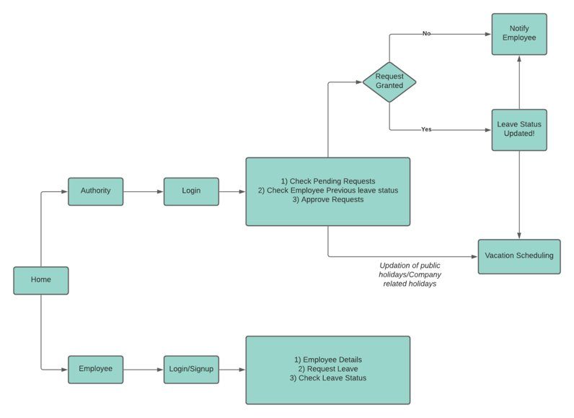
BLOCK DIAGRAM

Slide 8
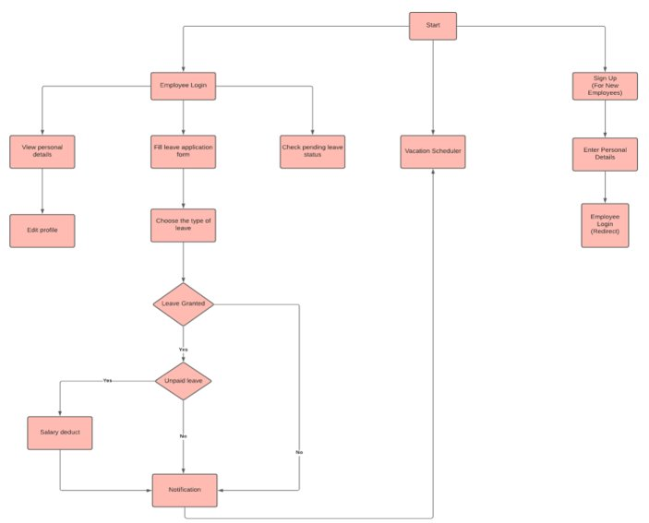
FLOW CHART (EMPLOYEE)

Slide 9
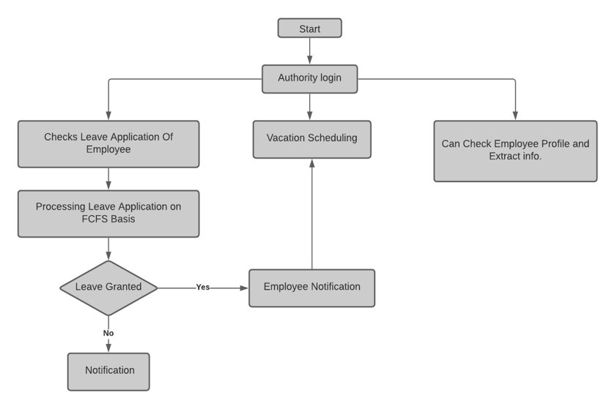
FLOW CHART (AUTHORITY)

Slide 10
Vacation Scheduling
Vacation Scheduler is a system to keep track of when the employees who are on vacation or away from the office.
The vacation scheduler helps all the staff to see employee availability, public holidays and institution events and holidays all at one place.
The scheduler makes tasks easier for both employees and the authorities, helps in hassle free and smooth process.

Slide 11
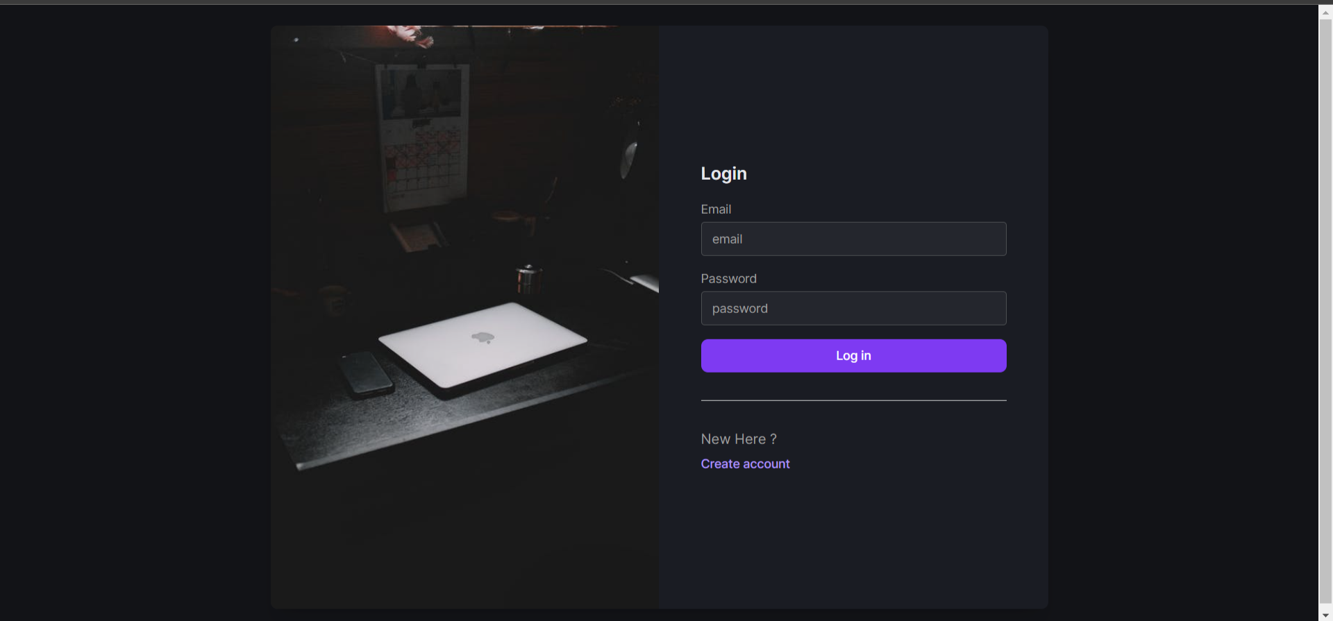
Employee Login Page

Slide 12
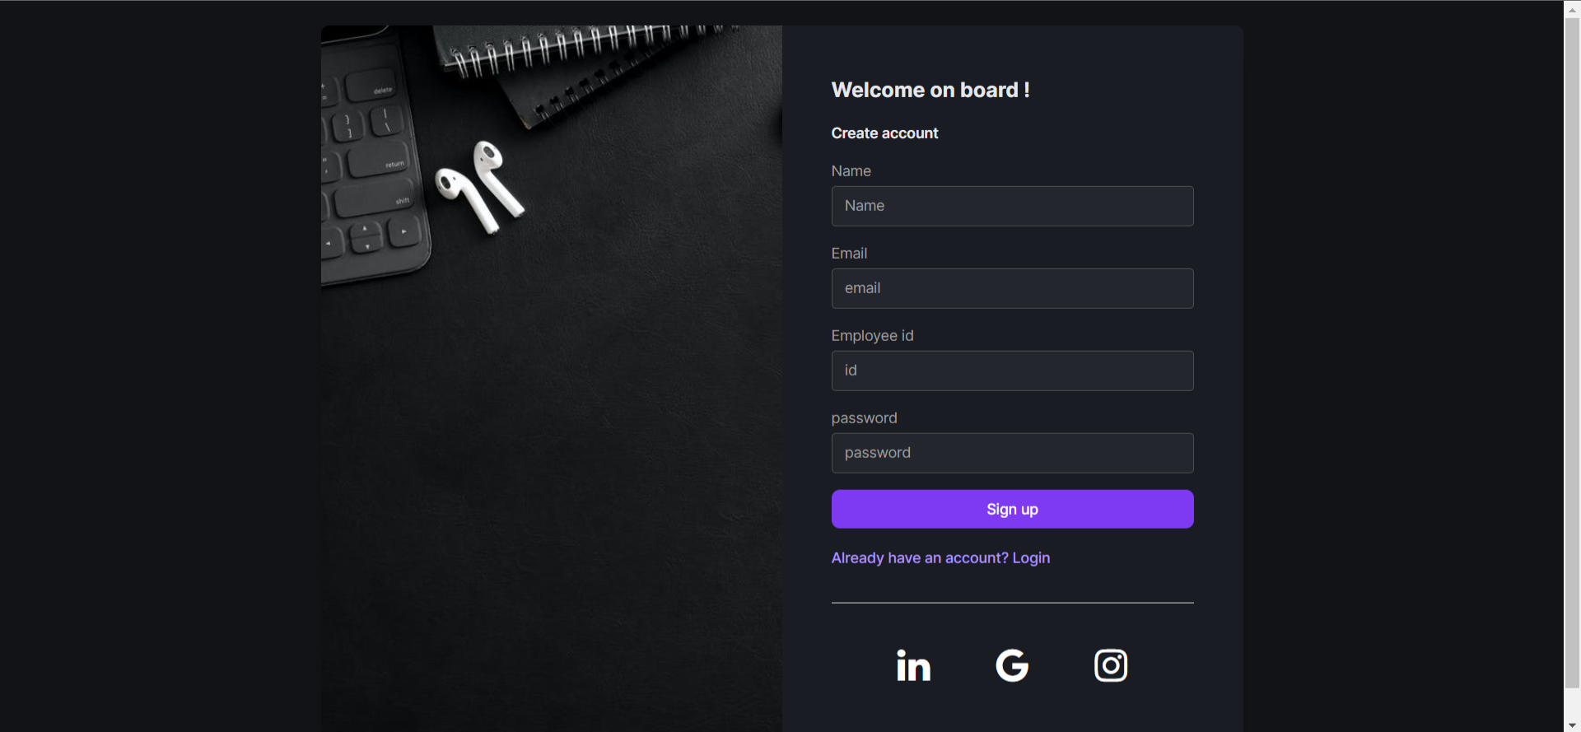
Employee Sign up Page

Slide 13
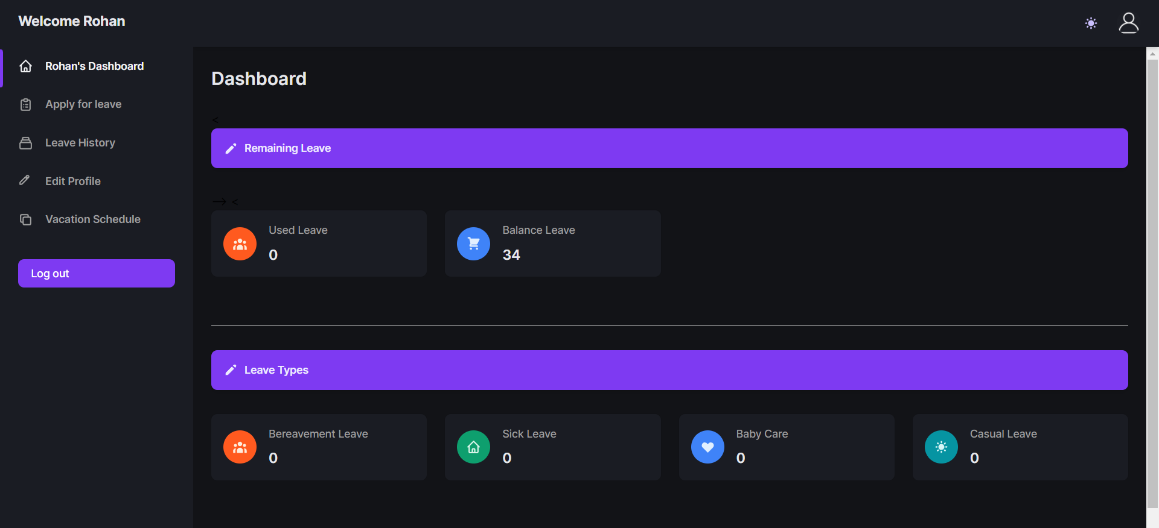
Employee Dashboard Page

Slide 14
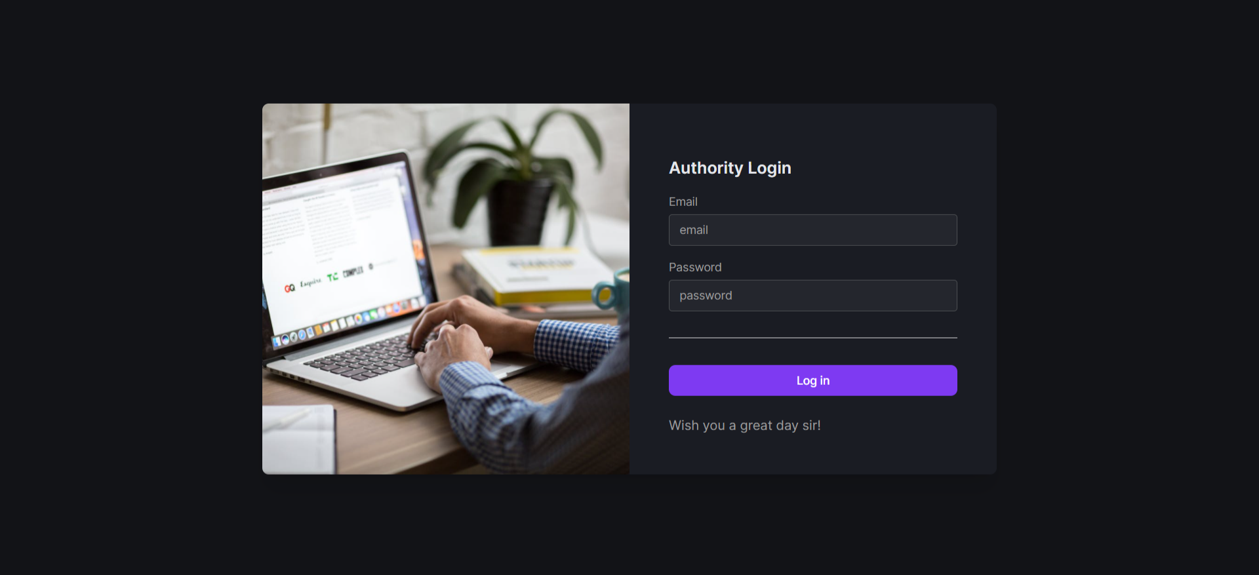
Authority Login Page

Slide 15
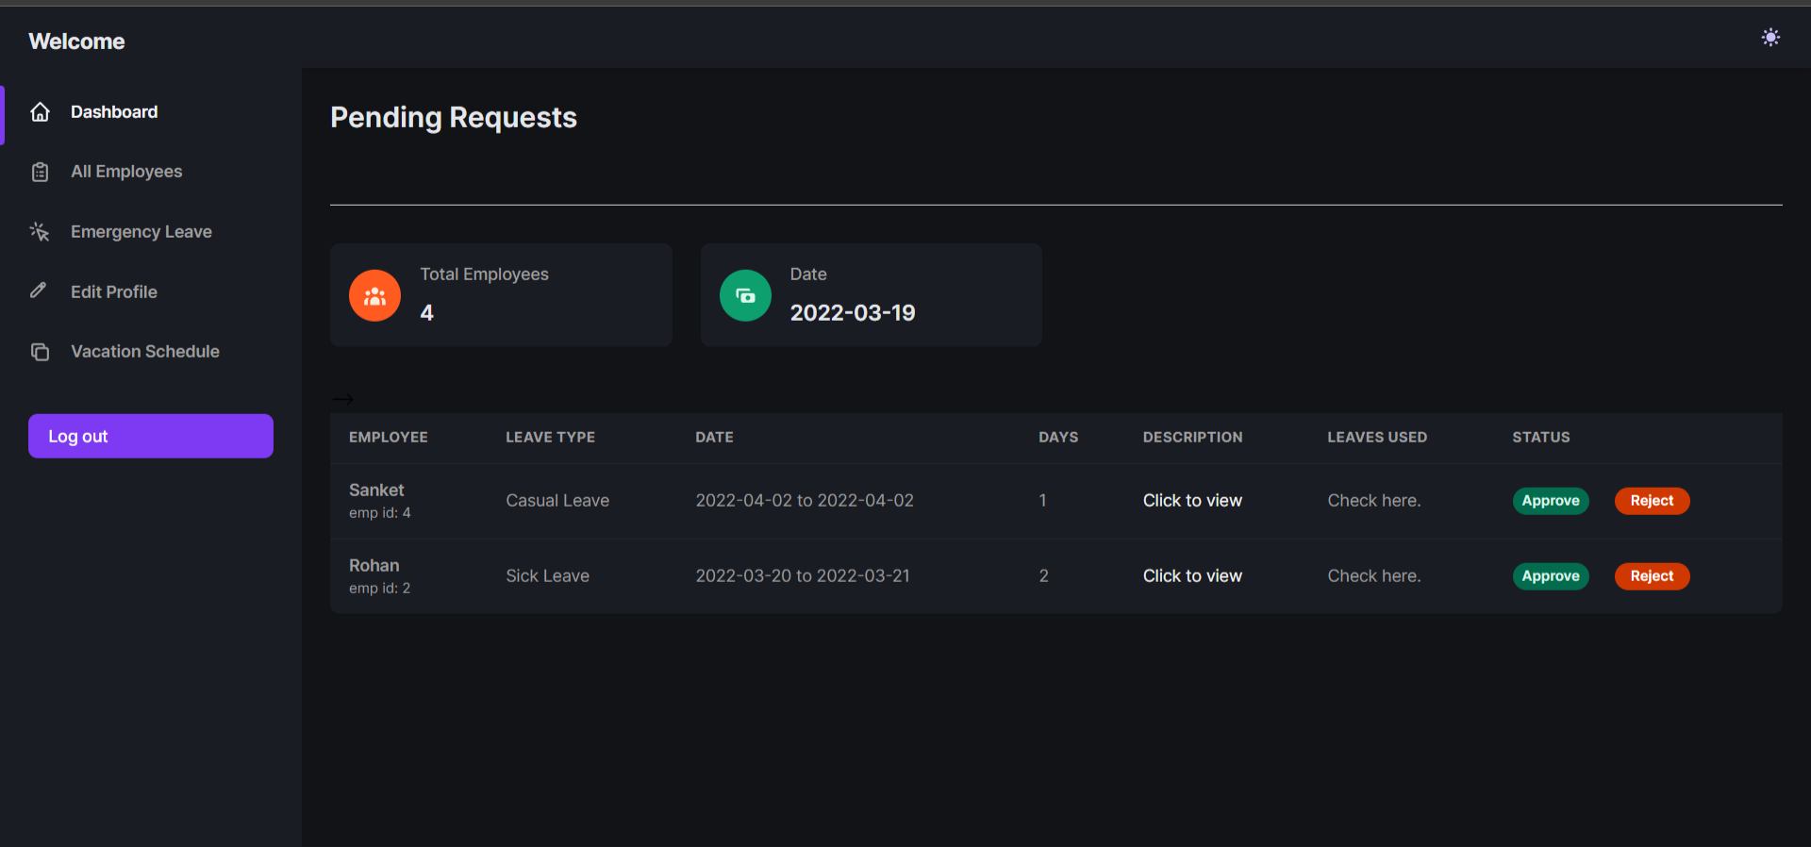
Authority Dashboard Page

Slide 16
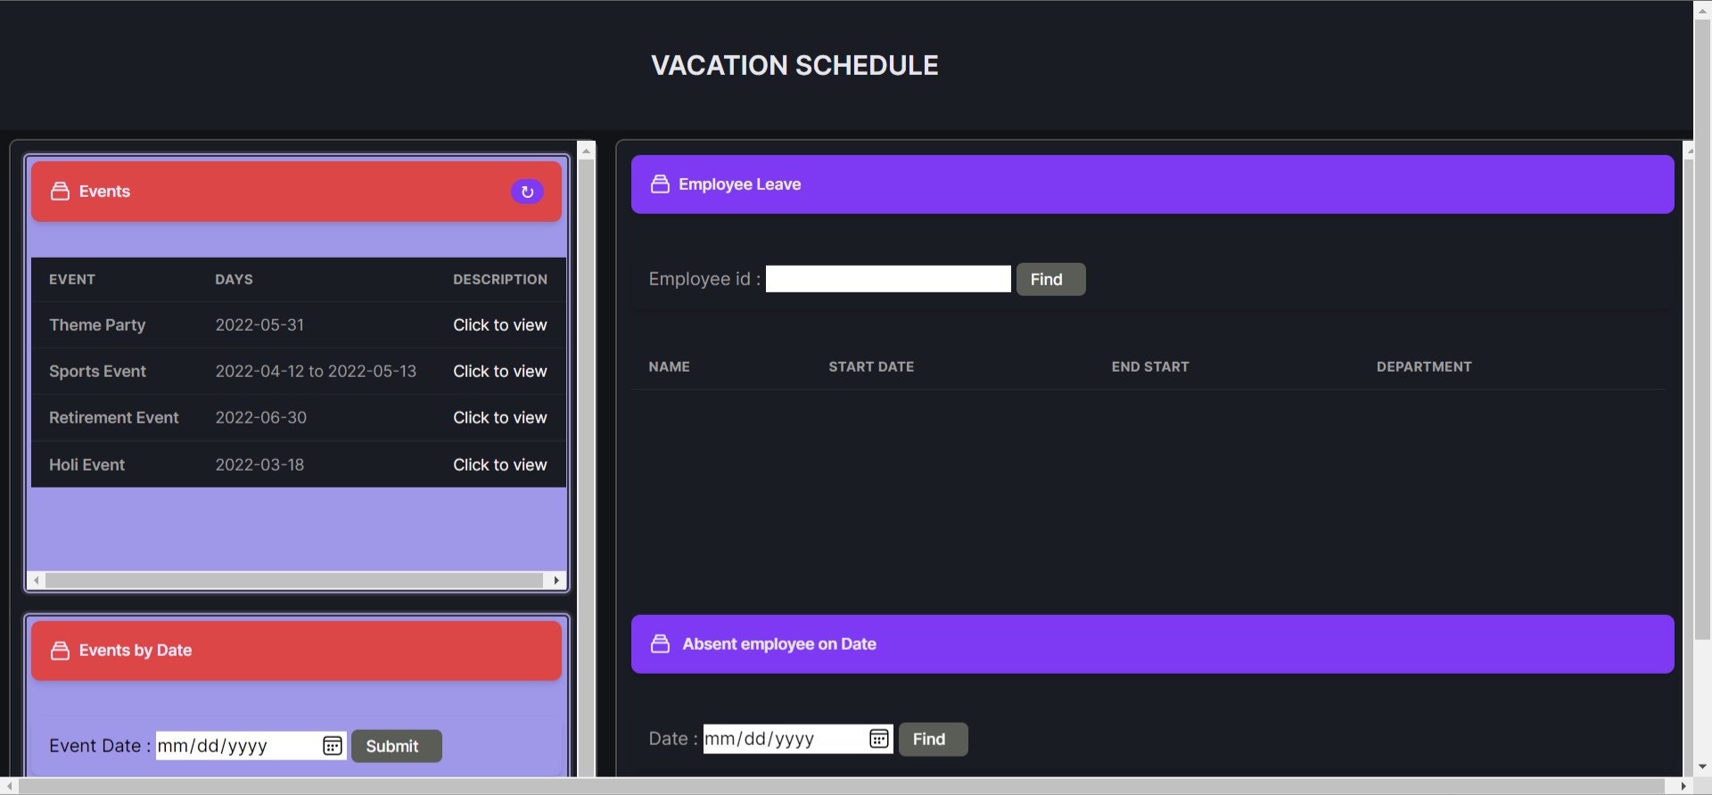
Vacation Scheduler

Slide 17
ADVANTAGES
Reduction of paper and manual work
Time saving due to digital management in software very less manual intervention.
Easy and safe access of records
Vacation scheduler is a one stop destination for staff to see all their leaves.
Visibility of employee availability
Clear communication and transparency of leaves of employees as every employee details are digitized.

Slide 18
CONCLUSION
Absence Request and Vacation Schedule Management system is very useful for any institution using it, to maintain the leave records of employees. This system will not only maintain the leave applications of the staff, it will also maintain the previous leave records of the staff.
The higher authority may accept or reject the applications requested by the employee. Thus this system maintains the excess amount of job done by the institution to maintain the leaves.
The system also approaches to reduce the formalities and delay by authority members for the approval of leave. The vacation scheduler helps all the staff to see their leaves, public holidays and institution holidays all at one place itself.

Slide 19
REFERENCES
Employee Leave Management System, “International Journal of Scientific & Engineering Research Volume 9”, (ISSN 2229-5518), February 2018.
Leave Management System, “Rashtrasant Tukadoji Maharaj Nagpur University,”, IEEE
https://www.w3schools.com/php/
https://developer.mozilla.org/en-US/docs/Learn/Getting_started_with_the_web/JavaScript_basics
https://www.moneycontrol.com/personal-finance/tools/gratuity-calculator.html

